Slide 1
ALERT SYSTEM FOR PATIENT MONITOR
-Siddharth S
Shagun Sengupta
JS-B2-G9

Slide 2
Agenda
Problem Statement
Technologies used
UML class diagram

Slide 3
Problem Statement
Sensing patient’s vital signs and generating alerts when any of the vitals go out of range.
Input : Patient ID on the console.
Generating input as if coming from patient monitor.
Output : Specific alerts for vitals going out of range.
Vital signs’ data as a JSON string .

Slide 4
Technologies Used
Implementation Language : JAVA
Development tool : Maven
IDE : Visual Studio

Slide 5
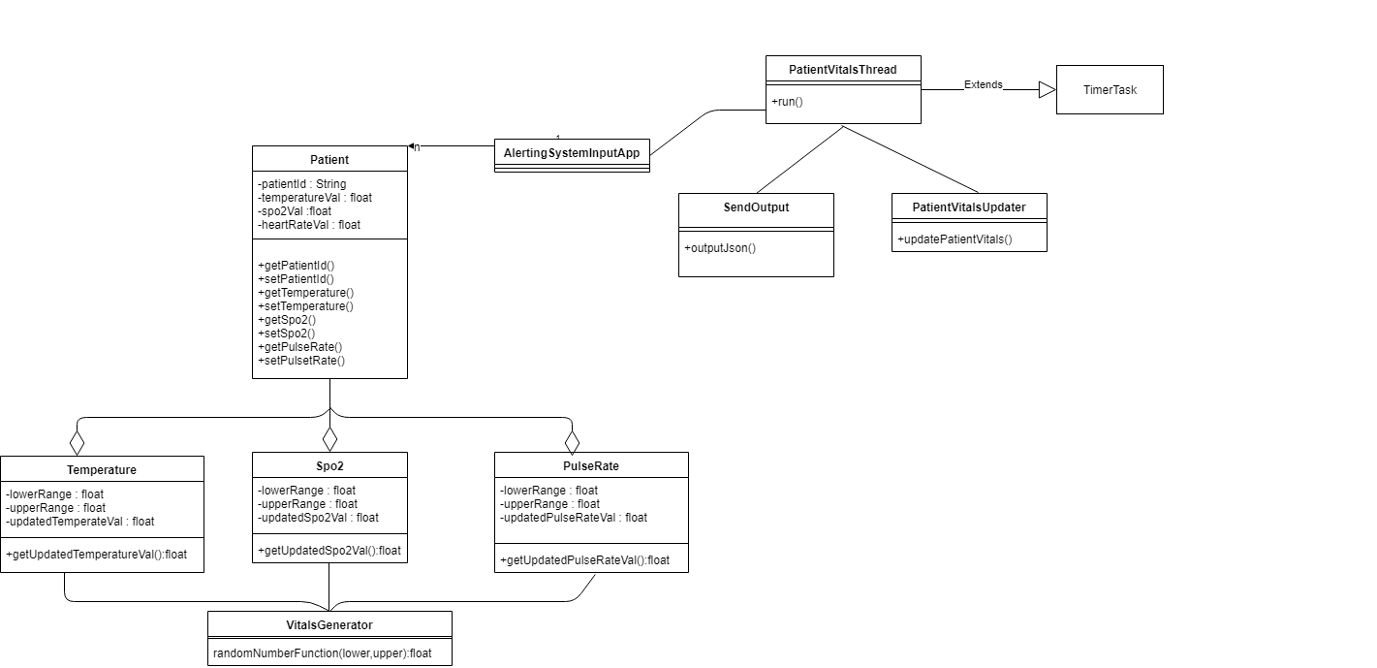
Class Diagram
Input System

Slide 6
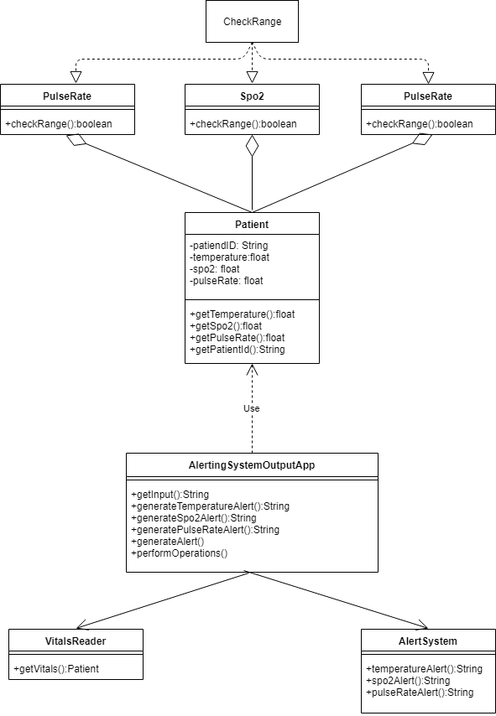
Alerting System

Slide 7
DEMONSTRATION

